Slide 1
Power BI @ the enterprise
PASS User Group Munich
Thomas “Tom” Martens

Slide 2

Agenda
01
Who we are and who am I
02
Self-service BI vs. Enterprise BI
03
Architectures
04
Power BI Licensing
05
Thank you

Slide 3

^{Who we are}
^{and}
^{who am I}

Slide 4











































b.telligent – Leading BI Consulting Company
Industries & Customers in the DACH Area
Topics
Range of Services
Partner
Telecommunication
Banks
Entertainment & Media
Big Data
Data Science
Data Warehousing
Planning
Reporting
Visual Analytics
Customer Intelligence
BI Strategy
Data Governance
Check
Trade & E-Commerce
Automotive
Insurance
Design
Suppliers
Industry
Travel
+200 other clients
Build
Development
Run
189
permanent employees
150
118
100
49
Optimize
50
0
2004
2009
2010
2011
2013
2016
2017
2019
Munich
+ Zurich
+ Hamburg
+ Dusseldorf
+ Stuttgart
+ Frankfurt
+ Berlin
+ 40 other

Slide 5










Thomas “Tom” Martens
Lead Expert
Diploma Business Administration (FH) - Controlling
Projects
Leading reinsurer
Major bank
International logistics specialist
Financial service provider
Energy supplier, trading and logistics
Expertise
Economic scientist with focus on controlling
Design and implementation of analytical solutions based on the MSFT Data Platform
Technical expertise, e.g. in the rollout of Power BI centered solutions in companies, based on cloud-only, on-premises, or hybrid architectures
Specialization in analytical architectures, data modeling, DAX and data visualization
Industries

Slide 6
^{Self-service BI} ^{vs. (or maybe and)}
^{Enterprise BI ?!}

Slide 7


Self-service BI vs. (or maybe and) Enterprise BI
Self-service
BI
Enterprise
BI
Driven by the need for speed
Challenges: amount of data, complexity, be in synch with regulatory requirements and data governance
Driven by Information and Data Governance
Challenges: evergrowing demand for new insights
Notes:
Information Governance: Maximize the added value from information
Data Governance: Align Storage, Transformation, Security, Data Lineage, Master Data Management

Slide 8
Agile BI vs. (or maybe and) Enterprise BI
Reporting & Portal
Self-Service BI
Data Analytics
Consumer
Report Developer
Business Analyst
Pro User
Champion
Data Scientist
Data Engineer
Standard Reporting
Portal
Managed Dashboards
Self-Service Visualization
Self-Service Modelling (Single Source)
Self-Service Modelling (Multiple Sources)
Self-Service Dashboarding
Analytics
Statistics

Slide 9
Agile BI vs. (or maybe and) Enterprise BI
Reporting & Portal
Self-Service BI
Data Analytics
Consumer
Report Developer
Business Analyst
Pro User
Champion
Data Scientist
Data Engineer
Standard Reporting
Portal
Managed Dashboards
Self-Service Visualization
Self-Service Modelling (Single Source)
Self-Service Modelling (Multiple Sources)
Self-Service Dashboarding
Analytics
Statistics

Slide 10
Self-service BI and its challenges
Works Council
Provisioning Process
Mobile App (Corporate, BYOD)
Compliance & Data Security
Governance

Slide 11
^{Architecture}

Slide 12



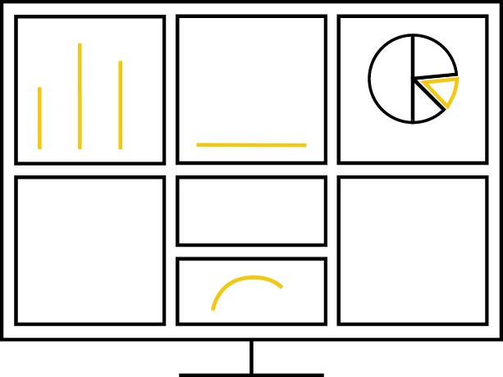


A picture from the past (but still valid)
Data source
DWH- / BI-System
Any kind of data sources
DWH
(relational)
Analytical Database
Data Visualization (Dashboards / Reports)
SQL Server
Analysis Services
Stage
Core
Star
SSRS Power BI
Self-Service BI
Power BI Desktop
Meta-Data
Analysis Services
Master Data Management (MSFT Master Data Services)

Slide 13

On-premises and the cloud
Model
Analysieren
Teilen
Visualize
Azure Analysis Services
Self-Service BI
Power BI
End User BI
Power BI Service
DATA
DATA
Mobile
Cloud
On–premises data gateway
On-premises
Web
SQL Server
Analysis Services
Power BI
Report Server
Excel
Power BI Desktop
Embedded

Slide 14
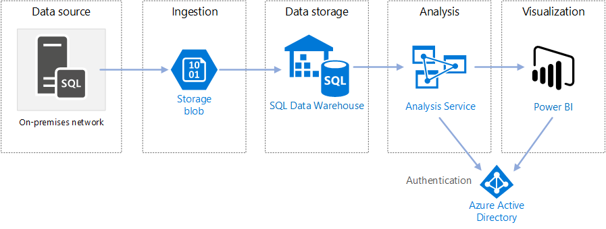
Data Warehousing Today (?!)
Notes:
source of the picture: https://docs.microsoft.com/en-us/azure/architecture/data-guide/relational-data/data-warehousing

Slide 15
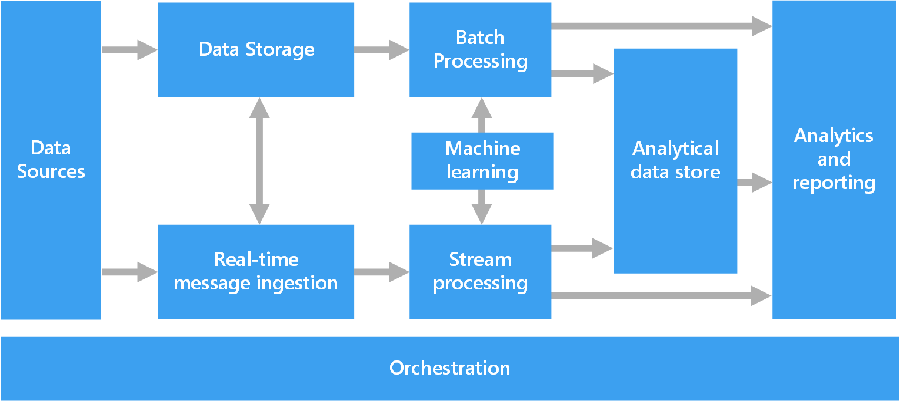
Now, the same procedure than every year – just bigger (the big data pipeline)
Notes:
source of the picture: https://docs.microsoft.com/en-us/azure/architecture/data-guide/big-data/#components-of-a-big-data-architecture

Slide 16
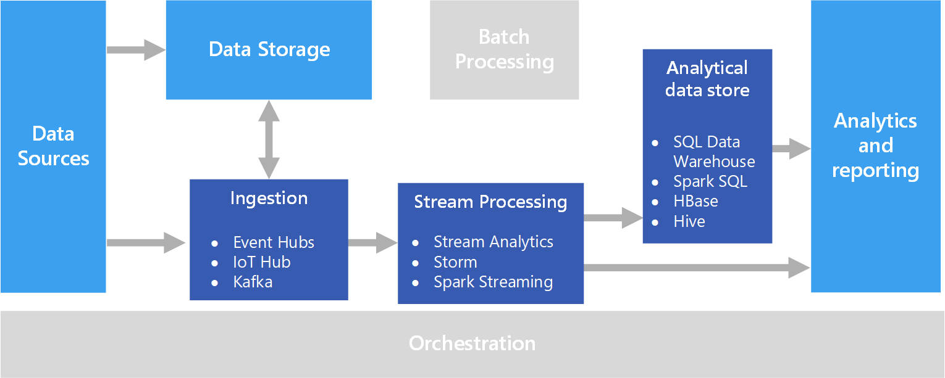
Now, not just bigger but also faster
Notes:
Source of the picture: https://docs.microsoft.com/en-us/azure/architecture/data-guide/big-data/real-time-processing

Slide 17


A more simple architecture, but more organizational challenges
PBI App
Tech. User
Sharepoint
Data Source
Specialist
PBI App
Tech. User
SharePoint
Data Source Specialist
RLS – Row Level Security

Slide 18
The future is bright ☺
Self-service BI yesterday
Self-service BI and Enterprise BI will melt
Data Model
Composite Data Models
Aggregations
Shared Datasets
CDM
dataflows
ADLS Gen2
Content 1
Content 2
Content 1
Content 2
Content n

Slide 19
^{Power BI Licensing}

Slide 20
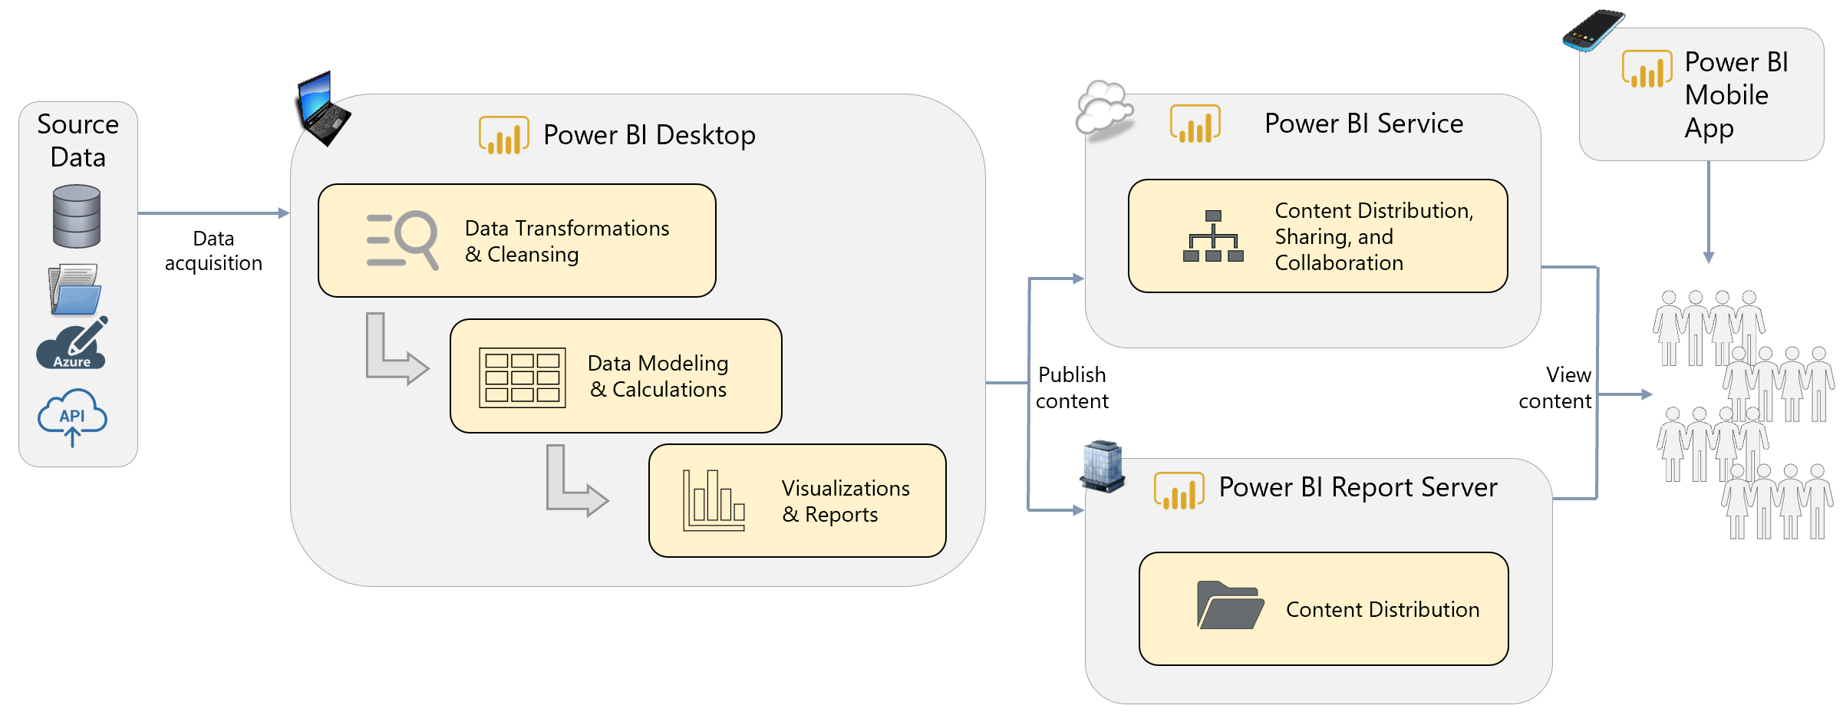
Power BI – Basic Architecture

Slide 21
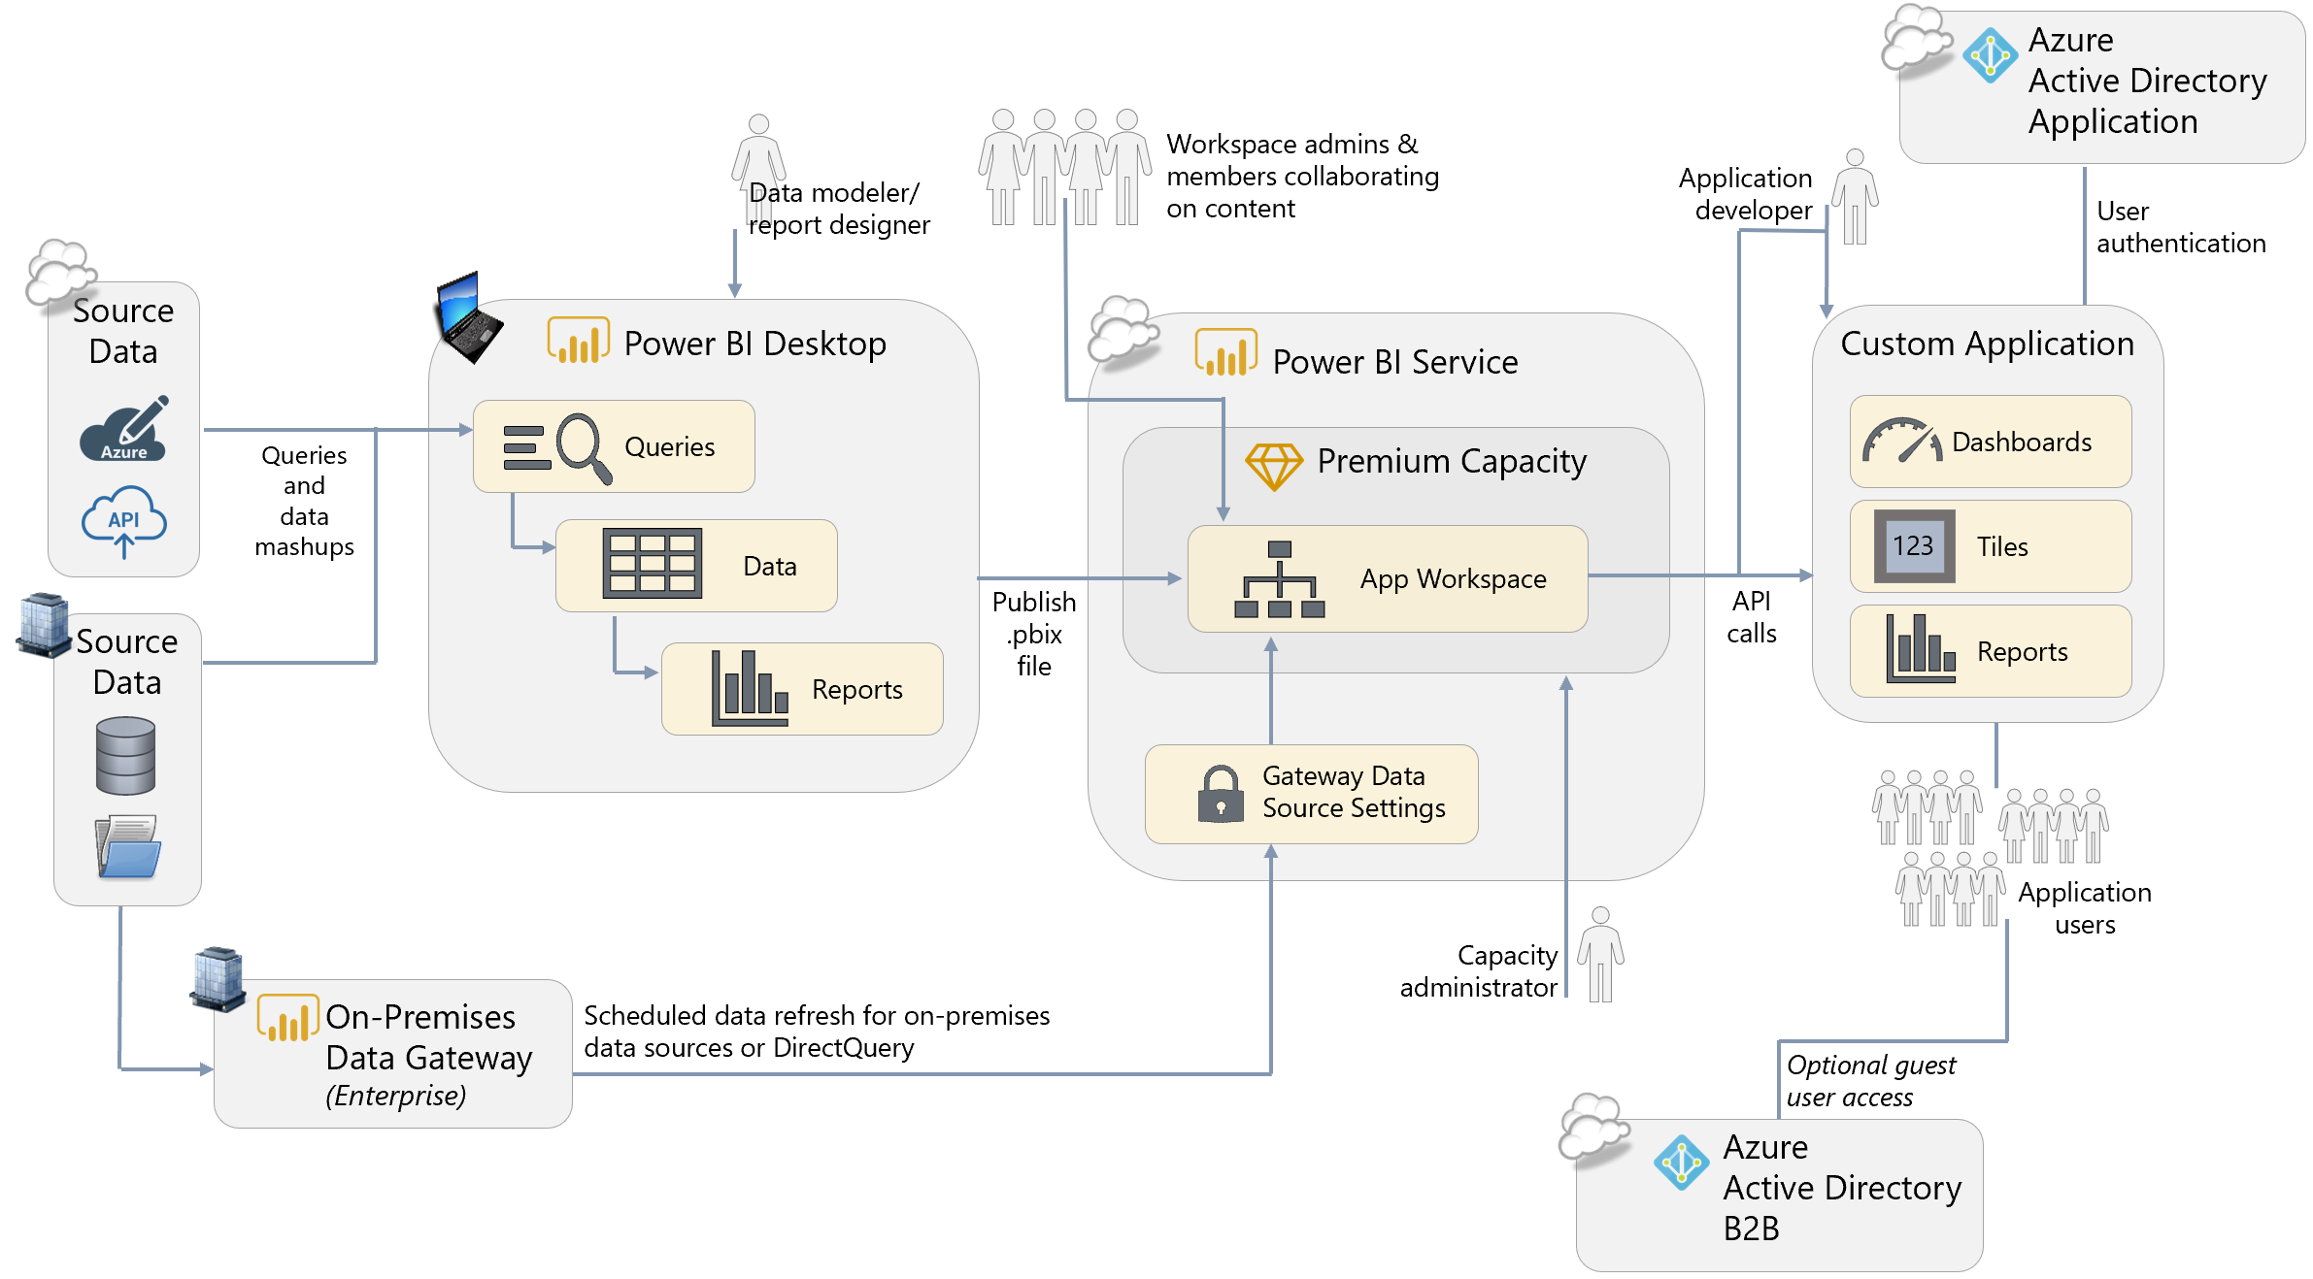
Power BI – Dedicated Capacity (Premium & Embedded)

Slide 22

Power BI Licensing
Power BI Premium – P3 16 cores / 100 GB
Power BI Premium – P2 8 cores / 50 GB
on-premises
cloud based
Power BI Report Server
Power BI Service
Power BI Premium – P1 4 cores / 25 GB
Free (combined with SQL Server Enterprise and Software Assurance) or
Power BI Premium Voucher
Power BI Service
Limitations
Power BI Premium
Capacity Plans
Shared Resources
1GB Model Size
Number of daily refreshes
More Users
Larger Models
Dedicated backend resources
Based on Power BI Pro licences
Based on Power BI (free) licences
Power BI Pro licences for authoring and administration

Slide 23








Power BI Licenses and tasks
Type
Roles
License
Premium or Pro
Power BI App
Consumers
Published/Final Version
Power BI Service
View in browser and with
iPhone, iPad
View dashboards, reports, workbooks, datasets
Publish app
Power BI App
Workspace
Admin
Manage members
Working/Draft Version
Pro
Member
Edit workspace items
Publish to cloud
Power BI Desktop
User
Free
Already licensed

Slide 24

7,9
7,9
Thomas Martens
thomas.martens@btelligent.com @tommartens68
CC Business Data Solutions
Lead Expert
Thank you!
b.telligent
GmbH & Co. KG
Walter-Gropius-Straße 17
80807 München
+49 89 122 281 110
www.btelligent.com
0
0
7,9
7,9

